Slide 1

Unit 01.04.03
CS 5220:
COMPUTER COMMUNICATIONS
CRC Capability; Internet Checksum
XIAOBO ZHOU, Ph.D.
Professor, Department of Computer Science

Slide 2
CRC Encoding - Recab
Multiply i(x) by n-k; (puts n-k zeros in (n-k) low order positions)
Divide x^{n-k} i(x) by g(x), and get a remainder polynomial r(x) of at most degree n-k-1. The remainder is the CRC checkbits;
Add remainder r(x) to x^{n-k} i(x); (put check bits in the n-k lower-order positions). The resulted polynomial will be transmitted codeword
b(x) = x^{n-k} i(x) + r(x)

Slide 3
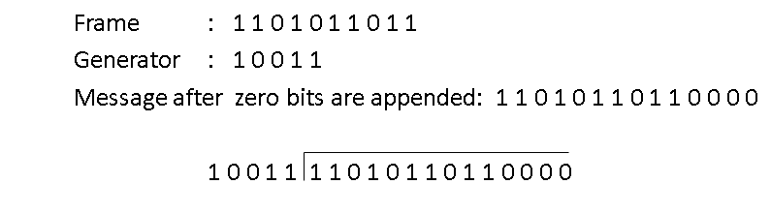
An Example – Step-by-Step

Slide 4
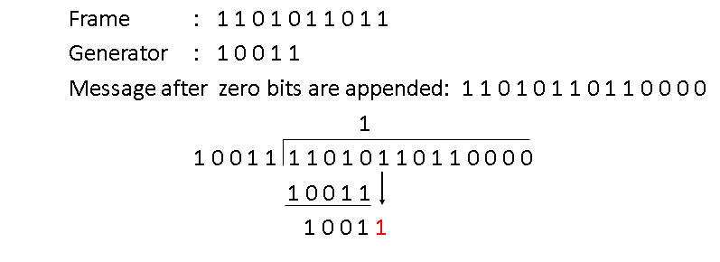
An Example – Step 1

Slide 5
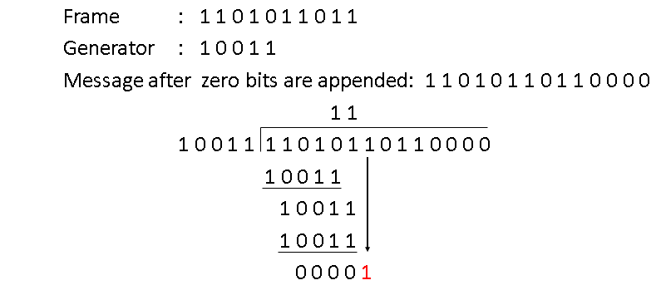
An Example – Step 2

Slide 6
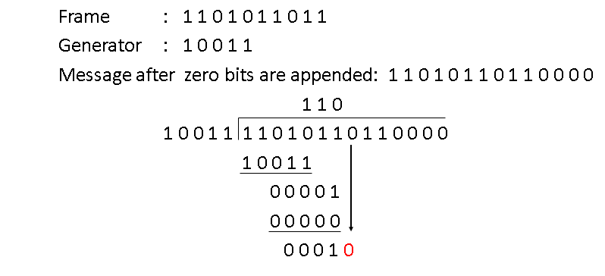
An Example – Step 3

Slide 7
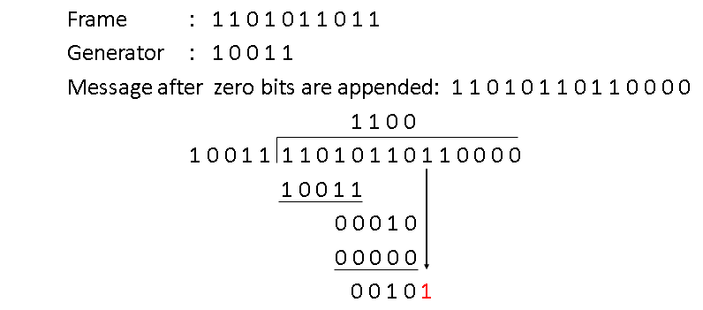
An Example – Step 4

Slide 8
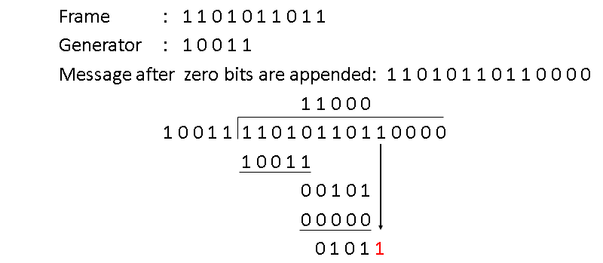
An Example – Step 5

Slide 9
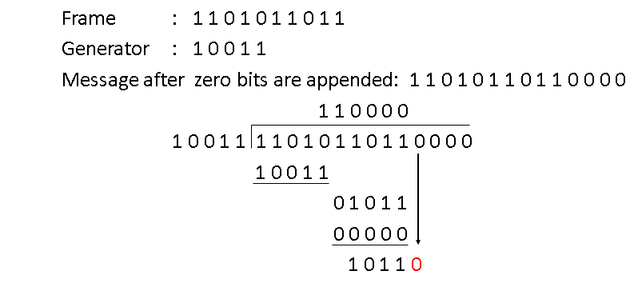
An Example – Step 6

Slide 10
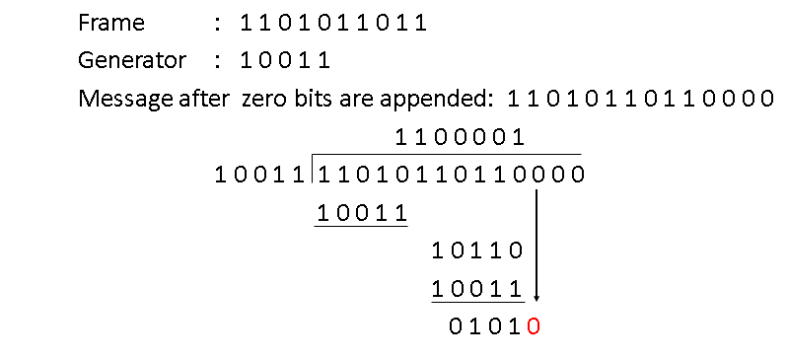
An Example – Step 7

Slide 11
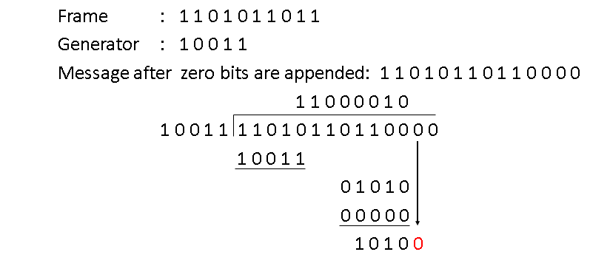
An Example – Step 8

Slide 12
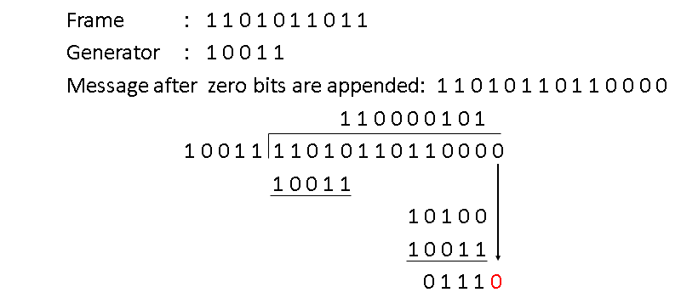
An Example – Step 9

Slide 13
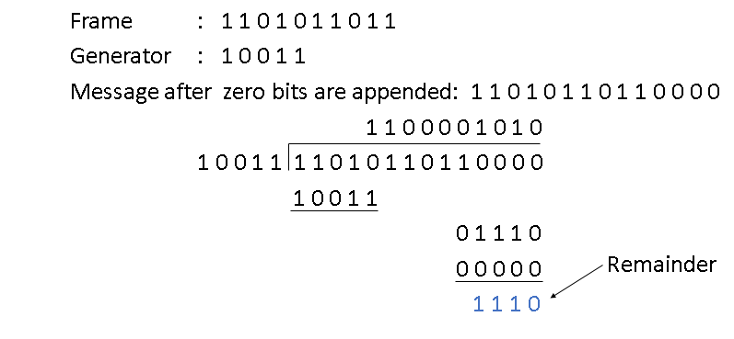
An Example – Step 10

Slide 14
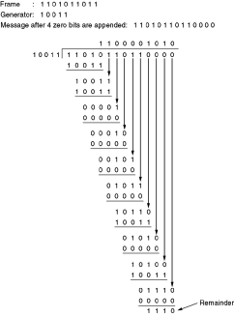
Overall

Slide 15
CRC Capability Analysis
What kind of errors will be detected?
Imagine that a transmission error e(x) occurs, so that instead of b(x) arriving, b(x) + e(x) arrives.
e(x) has 1s in error locations & 0s elsewhere, an additive error model adding bit-by-bit to the input codeword b(x) using modulo 2 arithmetic
(Transmitter)
(Receiver)
b(x)
+
R(x)=b(x)+e(x)
  e(x)
Error polynomial
(Channel)

Slide 16
Undetectable Error Patterns
Receiver divides the received polynomial R(x) by g(x)
Blindspot: If e(x) is a multiple of g(x), that is, e(x) is a nonzero codeword, then
R(x) = b(x) + e(x) = q(x)g(x) + q’(x)g(x)
If e(x) is divisible by g(x), the error will slip by! So, how we select g(x)?
(Transmitter)
(Receiver)
b(x)
+
R(x)=b(x)+e(x)
  e(x)
Error polynomial
(Channel)

Slide 17
Designing Good Polynomial Codes
Select generator polynomial so that likely error patterns are not multiples of g(x)
Detecting Single Errors
  e(x) = x^{i} for error in location i + 1
  If g(x) has more than 1 term, it cannot divide x^{i}
Detecting Double Errors
  e(x) = x^{i} + x^{j} = x^{i}(x^{j-i}+1) where j>i
  If g(x) has more than 1 term, it cannot divide x^{i}
  If g(x) is a primitive polynomial, it cannot divide x^{m}+1 for all m<2^{n-k}-1 (Need to keep codeword length less than 2^{n-k}-1)
  Primitive polynomials can be found by consulting coding theory books

Slide 18
Designing Good Polynomial codes
Detecting Odd Numbers of Errors
  Suppose all codeword polynomials have an even # of 1s, then all odd numbers of errors can be detected
  As well, b(x) evaluated at x = 1 is zero because b(x) has an even number of 1s
  This implies x + 1 must be a factor of all b(x)
  Pick g(x) = (x + 1) p(x) where p(x) is primitive

Slide 19
Standard CRC Generator Polynomials
CRC-8:
CRC-16:
CCITT-16:
CCITT-32:
ATM
= x⁸ + x² + x + 1
Bisync
= x¹⁶ + x¹⁵ + x² + 1
= (x + 1)(x¹⁵ + x + 1)
HDLC, XMODEM, V.41
= x¹⁶ + x¹² + x⁵ + 1
IEEE 802, DoD, V.42
= x³² + x²⁶ + x²³ + x²² + x¹⁶ + x¹² + x¹¹ + x¹⁰ + x⁸ + x⁷ + x⁵ + x⁴ + x² + x + 1

Slide 20
Internet Checksum
Internet Protocols (IP, TCP, UDP) use check bits to detect errors, instead of using CRC polynomial
The rationale is the simplicity: the checksum must be recalculated at every router, the algorithm for the checksum was selected for its ease of implementation, instead of strength of error detection capability

Slide 21
Internet (IP) Checksum Algorithm
Let IP header consists of L, 16-bit words, b₀, b₁, b₂, ..., b_{L-1}
The algorithm appends a 16-bit checksum b_{L} to the header. The checksum b_{L} is calculated as follows:
Treating each 16-bit word as an integer, find
x = (b₀ + b₁ + b₂+ ...+ b_{L-1} ) modulo 2¹⁶-1
The checksum is then given by: b_{L} = - x
Thus, the headers must satisfy the following pattern:
0 = (b₀ + b₁ + b₂+ ...+ b_{L-1} + b_{L} ) modulo 2¹⁶-1
The checksum calculation is carried out in software using one’s complement arithmetic

Slide 22
Internet Checksum Example
Assume 4-bit words
Use mod 2⁴-1 arithmetic
b0=1100 = 12
b1=1010 = 10
Use Modulo Arithmetic
Use Binary Arithmetic

Slide 23
Internet Checksum Example
Use Modulo Arithmetic
Assume 4-bit words
Use mod 2⁴-1 arithmetic
b₀=1100 = 12
b₁=1010 = 10
b₀+b₁=12+10=7 mod15
b₂ = -7 = 8 mod15
Therefore
b₂=1000
Use Binary Arithmetic
Note 16 mod15 =1
So: 10000 mod15 = 0001
leading bit wraps around
b₀ + b₁ = 1100+1010
=10110
=10000+0110
=0001+0110
=0111
=7
Take 1s complement b₂ = -0111 =1000

Slide 24
Summary of the Lesson
  Choosing good generator polynomial codes determine the capability of CRC error detection.
  Internet checksum values more on ease of implementation than on detection capability.

